Slide 1
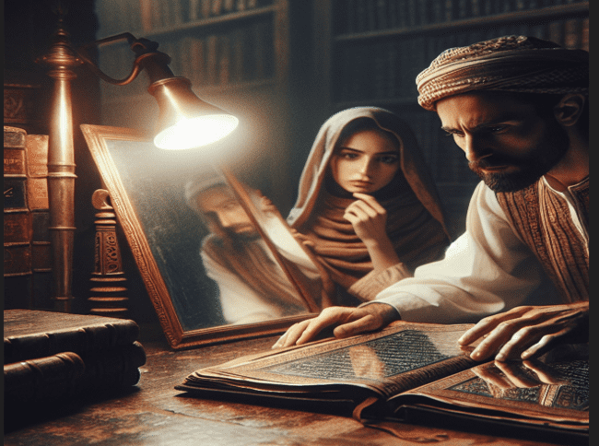

Examine
Your
Own Selves
II Corinthians 13:5

Slide 2
II Corinthians 13:5 (NLT)
Examine yourselves to see if your faith is genuine. Test yourselves. Surely you know that Jesus Christ is among you; if not, you have failed the test of genuine faith.

Slide 3
II Corinthians 13:1-10 (NLT)
¹ This is the third time I am coming to visit you (and as the Scriptures say, "The facts of every case must be established by the testimony of two or three witnesses"). ² I have already warned those who had been sinning when I was there on my second visit.

Slide 4
II Corinthians 13:1-10 (NLT)
Now I again warn them and all others, just as I did before, that next time I will not spare them. ³ I will give you all the proof you want that Christ speaks through me. Christ is not weak when he deals with you; he is powerful among you.

Slide 5
II Corinthians 13:1-10 (NLT)
⁴ Although he was crucified in weakness, he now lives by the power of God. We, too, are weak, just as Christ was, but when we deal with you we will be alive with him and will have God's power.

Slide 6
II Corinthians 13:1-10 (NLT)
⁵ Examine yourselves to see if your faith is genuine. Test yourselves. Surely you know that Jesus Christ is among you; if not, you have failed the test of genuine faith.

Slide 7
II Corinthians 13:1-10 (NLT)
⁶ As you test yourselves, I hope you will recognize that we have not failed the test of apostolic authority. ⁷ We pray to God that you will not do what is wrong by refusing our correction. I hope we won't need to demonstrate our authority when we arrive.

Slide 8
II Corinthians 13:1-10 (NLT)
Do the right thing before we come—even if that makes it look like we have failed to demonstrate our authority. ⁸ For we cannot oppose the truth, but must always stand for the truth. ⁹ We are glad to seem weak if it helps show that you are actually strong.

Slide 9
II Corinthians 13:1-10 (NLT)
We pray that you will become mature. ¹⁰ I am writing this to you before I come, hoping that I won't need to deal severely with you when I do come. For I want to use the authority the Lord has given me to strengthen you, not to tear you down.

Slide 10
Examine Your Own Selves
Self-Evaluation Needs:
Reflect
Respond
Rely

Slide 11
Point #1: Reflect
I Corinthians 11:26-30 (KJV)
Psalms 26 (NAS)
Lamentations 3:40 (NAS)

Slide 12
I Corinthians 11:26-30 (KJV)
²⁶ For as often as ye eat this bread, and drink this cup, ye do shew the Lord's death till he come. ²⁷ Wherefore whosoever shall eat this bread, and drink this cup of the Lord, unworthily, shall be guilty of the body and blood of the Lord.

Slide 13
I Corinthians 11:26-30 (KJV)
²⁸ But let a man examine himself, and so let him eat of that bread, and drink of that cup. ²⁹ For he that eateth and drinketh unworthily, eateth and drinketh damnation to himself, not discerning the Lord's body.

Slide 14
I Corinthians 11:26-30 (KJV)
³⁰ For this cause many are weak and sickly among you, and many sleep.

Slide 15
Psalms 26 (NAS)
¹ Vindicate me, LORD, for I have walked in my integrity, And I have trusted in the LORD without wavering. ² Examine me, LORD, and put me to the test; Refine my mind and my heart.

Slide 16
Psalms 26 (NAS)
³ For Your goodness is before my eyes, And I have walked in Your truth. ⁴ I do not sit with deceitful people, Nor will I go with pretenders. ⁵ I hate the assembly of evildoers, And I will not sit with the wicked.

Slide 17
Psalms 26 (NAS)
⁶ I will wash my hands in innocence, And I will go around Your altar, LORD, ⁷ That I may proclaim with the voice of thanksgiving And declare all Your wonders. ⁸ LORD, I love the dwelling of Your house, And the place where Your glory remains.

Slide 18
Psalms 26 (NAS)
⁹ Do not take my soul away along with sinners, Nor my life with men of bloodshed, ¹⁰ In whose hands is a wicked scheme, And whose right hand is full of bribes.

Slide 19
Psalms 26 (NAS)
¹¹ But as for me, I will walk in my integrity; Redeem me, and be gracious to me. ¹² My foot stands on level ground; In the congregations I will bless the LORD.

Slide 20
Lamentations 3:40 (NAS)
Let's examine and search out our ways, And let's return to the LORD.

Slide 21
Point #2: Respond
II Timothy 2:15 (AMP)
Romans 12:2 (ESV)
James 1:12 (AMP)

Slide 22
II Timothy 2:15 (AMP)
Study and do your best to present yourself to God approved, a workman tested by trial who has no reason to be ashamed, accurately handling and skillfully teaching the word of truth.

Slide 23
Romans 12:2 (ESV)
Do not be conformed to this world, but be transformed by the renewal of your mind, that by testing you may discern what is the will of God, what is good and acceptable and perfect.

Slide 24
James 1:12 (AMP)
Blessed happy, spiritually prosperous, favored by God is the man who is steadfast under trial and perseveres when tempted;

Slide 25
James 1:12 (AMP)
for when he has passed the test and been approved, he will receive the victor's crown of life which the Lord has promised to those who love Him.

Slide 26
Point #3: Rely
Galatians 6:3-5 (NKJV)
Jeremiah 9:23-24 (NLT)

Slide 27
Galatians 6:3-5 (NKJV)
³ For if anyone thinks himself to be something, when he is nothing, he deceives himself. ⁴ But let each one examine his own work,

Slide 28
Galatians 6:3-5 (NKJV)
and then he will have rejoicing in himself alone, and not in another. ⁵ For each one shall bear his own load.

Slide 29
Jeremiah 9:23-24 (NLT)
²³ This is what the Lord says:
"Don't let the wise boast in their wisdom, or the powerful boast in their power, or the rich boast in their riches.

Slide 30
Jeremiah 9:23-24 (NLT)
²⁴ But those who wish to boast should boast in this alone: that they truly know me and understand that I am the Lord who demonstrates unfailing love and who brings justice and righteousness to the earth, and that I delight in these things.

Slide 31
Jeremiah 9:23-24 (NLT)
I, the Lord, have spoken!

Slide 32
Luke 9:23-25 (ETR)
²³ Jesus continued to say to all of them, "Any of you who want to be my follower must stop thinking about yourself and what you want. You must be willing to carry the cross that is given to you every day for following me.

Slide 33
Luke 9:23-25 (ETR)
²⁴ Any of you who try to save the life you have will lose it. But you who give up your life for me will save it.
²⁵ It is worth nothing for you to have the whole world if you yourself are destroyed or lost.

Slide 34
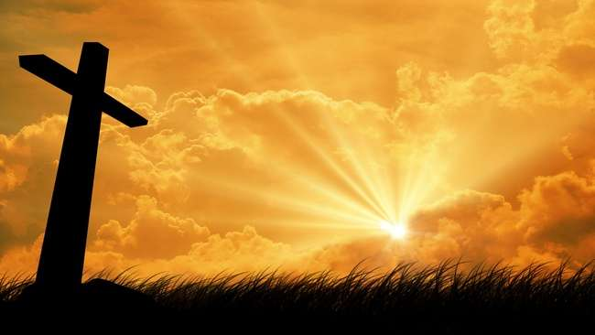
…that Christ died for our sins according to the scriptures;
And that he was buried, and that he rose again the third day according to the scriptures:

Slide 35
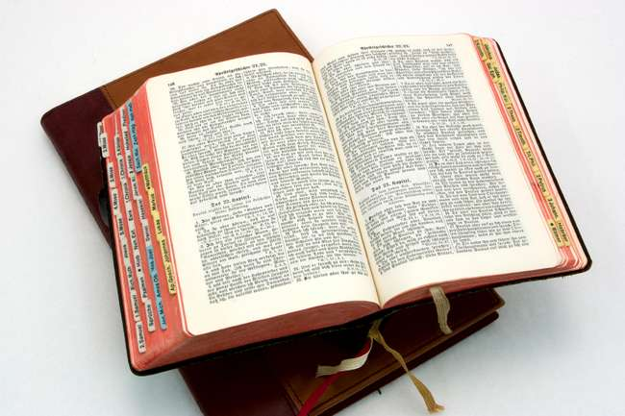
Hear: Romans 10:17
So then faith cometh by hearing, and hearing by the word of God.

Slide 36
Believe: Hebrews 11:6
But without faith it is impossible to please him: for he that cometh to God must believe that he is, and that he is a rewarder of them that diligently seek him.

Slide 37
Repent: Luke 13:3
I tell you, Nay: but, except ye repent, ye shall all likewise perish.

Slide 38
Confess: Matthew 10:32-33
32 Whosoever therefore shall confess me before men, him will I confess also before my Father which is in heaven.
33 But whosoever shall deny me before men, him will I also deny before my Father which is in heaven.

Slide 39
Baptize: Acts 22:16
And now why tarriest thou? arise, and be baptized, and wash away thy sins, calling on the name of the Lord.

